Slide 1
Chess Programming

Slide 2
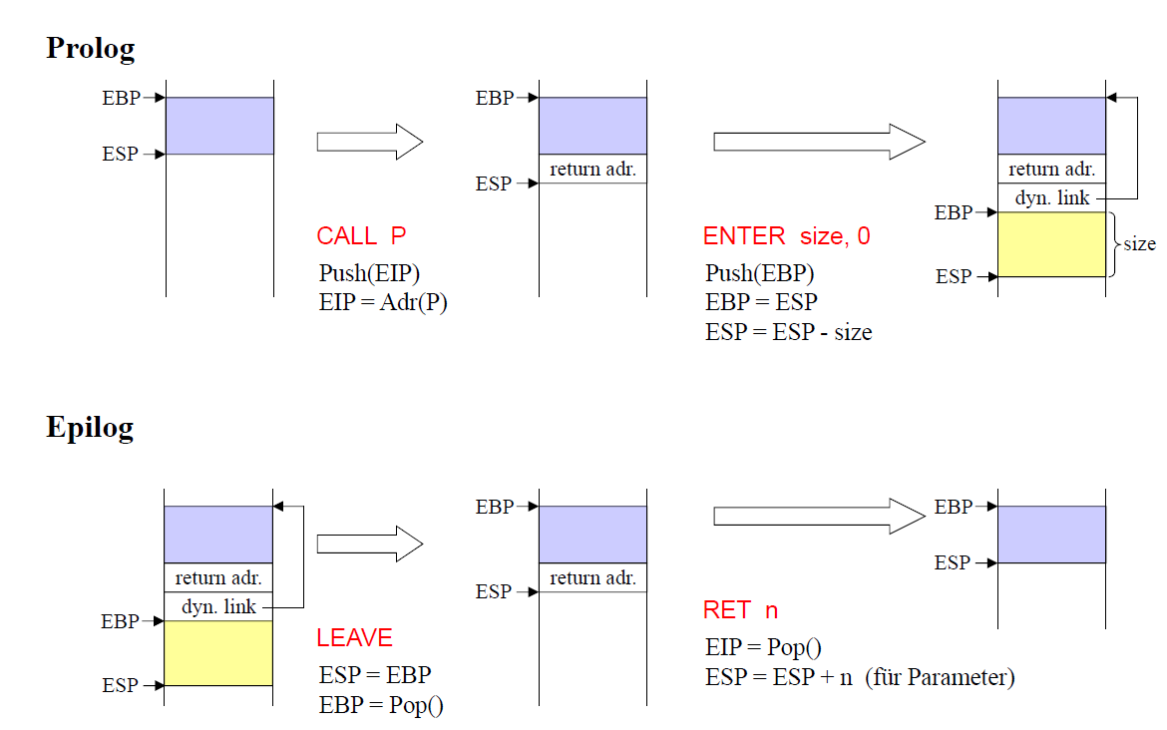
Iterative Solution
Reduce stack overhead:

Slide 3
Iterative Solution Comparison
Analysis are refering to opening move „wP d2-d4“
Performance becomes even worse:
Iterative solution: ~17901evaluations / sec
Classical MinMax: ~20000 evaluations / sec

Slide 4
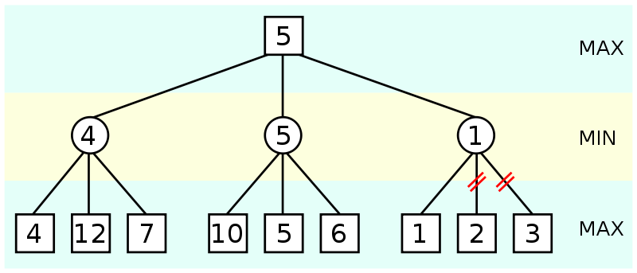
Alpha Beta Pruning
Alpha: Best already explored option for max
Beta: Best already explored option for min
Notes:
Describe Algorithm
Show Code

Slide 5
Performance Analysis
Number of evaluations after 4 levels:
Classical MinMax algorithm: 388000 evals
Alpha Beta algorithm: 49000 evals
~8/10 of all nodes could be pruned!

Slide 6
Alpha Beta pruning
NegaMax: 225000 moves / sec
Classical MinMax algorithm: ~17000 evals / sec
AlphaBeta Pruning algorithm: ~19000 evals / sec
NegaMax algorithm: ~230000 eval / sec
Still very poor performance

Slide 7
Negamax with Alpha Beta Pruning
NegaMax algorithm: ~230000 eval / sec and 4 levels
Alpha Beta NegaMax algo: ~111000 / sec eval and 5 levels

Slide 8
Other improvments
Award knights which are near the center
Award kings which are near the corner
Penalize double/triple pawn
Connected rooks
Queen in the center
Bishops not on the edge
Horizon effect

